Slide 1
matlab2
B0829060 黃至祥

Slide 2
Ex1.problem

Slide 3
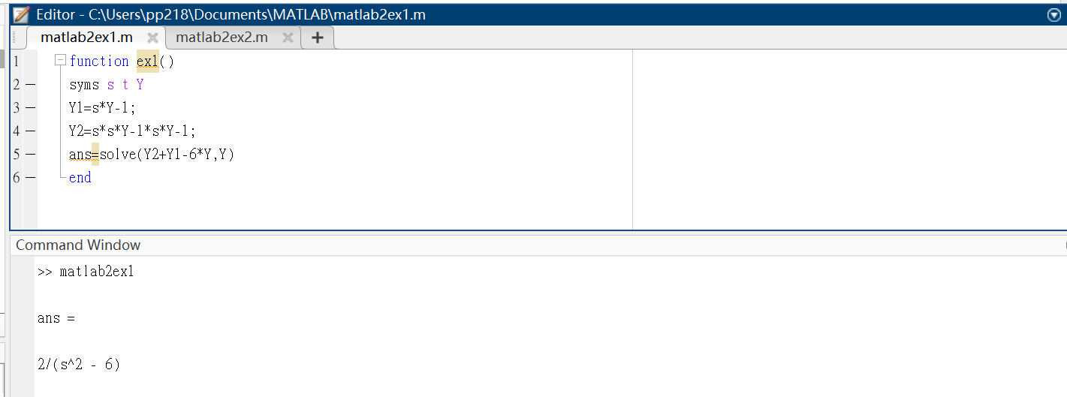
Ex1.ans

Slide 4
Ex2.problem

Slide 5
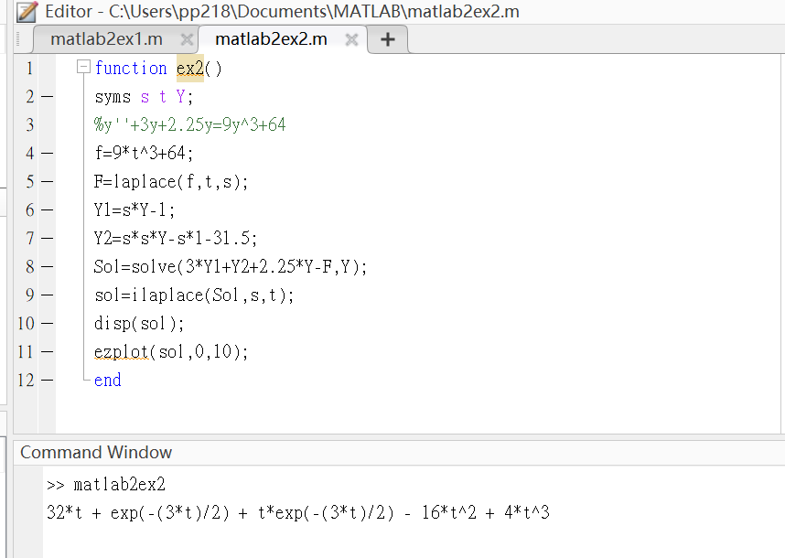
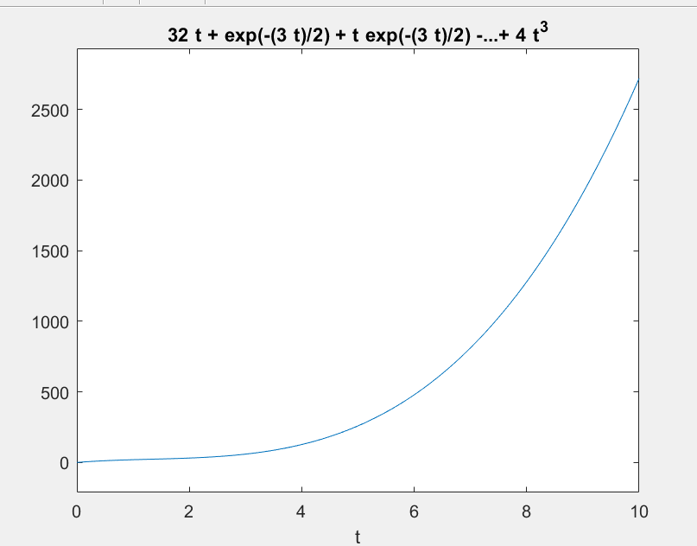
Ex2.ans

